Slide 1
Tweet Emotion Detection
By:
Kiran Venkatesh Kulkarni- 1001848434
Akhilesh mn- 1001848441
Diiya dasari- 1001934969
Kathankumar shah- 1001865662

Slide 2
INTRODUCTION
Twitter is a microblogging service where users from around the world publish and share their feelings. However, sentiment analysis for Twitter messages (‘tweets’) is regarded as a challenging problem because tweets are short and informal.
To solve this problem, we have used a Recurrent Neural Network.
Using TensorFlow as the machine learning framework, this multi class classification problem of the natural language processing domain is solved.
After training the model to recognize emotions in tweets, we can predict the emotion of a given tweet with high accuracy.

Slide 3
DATASET
The dataset consists of 20,000 tweets with their corresponding emotion.
The dataset is already pre-processed and divided into the training, test and validation set. Each tweet is based on an emotion in one of the six categories – love, fear, joy, sadness, surprise and anger.
The training set consists of 16,000 tweets, the test set consists of 2,000 tweets and the validation set also consists of 2,000 tweets.

Slide 4
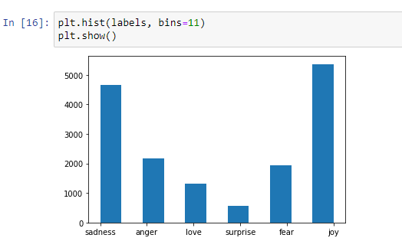
PREDICTION LABELS
There is a need of different numeric values for the different classes for multi class classifications. The classes are created using the labels from the training set. The six classes which represent the different emotions are - anger, joy, love, surprise, fear and sadness.
A histogram is plotted to see the number of tweets for the different classes

Slide 5
TRAINING THE MODEL
The validation set is prepared, and its sequences are generated. Its labels are also converted to their corresponding numerical representation.
The model is then trained for 15 epochs. The number of epochs is a hyperparameter of gradient descent that controls the number of complete passes through the training dataset.
An early stopping callback is also set which stops the training if the model does not see any improvement in the validation accuracy for over 2 epochs.

Slide 6
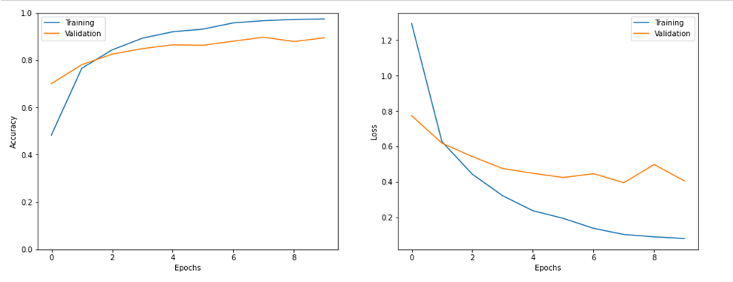
EVALUATING THE MODEL
Plots are generated for the accuracy and loss for the training and validation set over epochs.

Slide 7
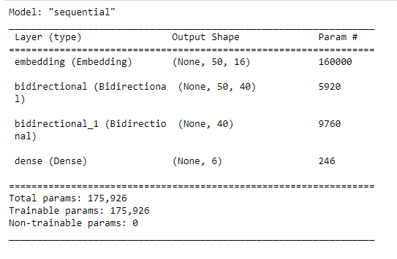
THE MODEL
The fist layer of the model is Embedding layer. The input length of sequence is going to be the maximum length which is 50. LSTM preserves information from inputs that has already passed through it using the hidden state. Unidirectional LSTM only preserves information of the past because the only inputs it has seen are from the past. Bidirectional LSTM will run the inputs in two ways, one from past to future and one from future to past and what differs this approach from unidirectional is that in the LSTM that runs backwards information from the future is preserved and using the two hidden states combined it is able in any point in time to preserve information from both past and future. The second is a bidirectional LSTM layer. This means that the contents from the LSTM layer can go for both left to right and right to left. Its 20 cells (each cell has its own inputs, outputs and memory) are used and return sequence is set to true which means that every time there will be an output which will be fed into another bidirectional LSTM layer it is sent as a sequence rather than a single value of each input so that the subsequent LSTM layer can have the required input. The final layer will be a Dense layer with 6 units for the six classes present and the activation is set to softmax which returns a probability distribution over the target classes. The model is compiled with loss set to ‘sparse_categorical_crossentropy’ as it is used for multi class classification problems as the classes are not one-hot encoded (for binary classes). The optimizer used is ‘adam’ as it is really efficient for working with large datasets.

Slide 8
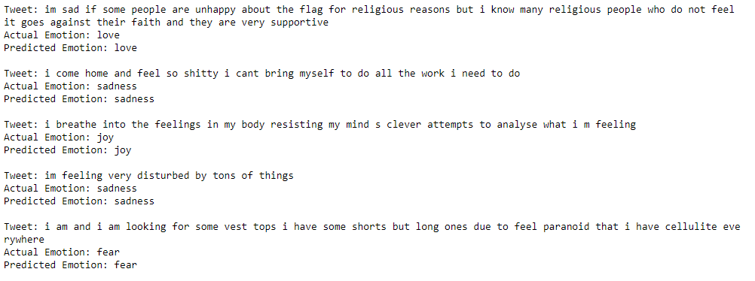
OUTPUT

Slide 9
RESULTS & OBSERVATIONS
In this project, a RNN model is constructed to recognize the emotions in tweets. The Model produces an accuracy rate of about 89%.
For further enhancements in future, a much larger dataset with more epochs can be used to increase the accuracy.

